Slide 1
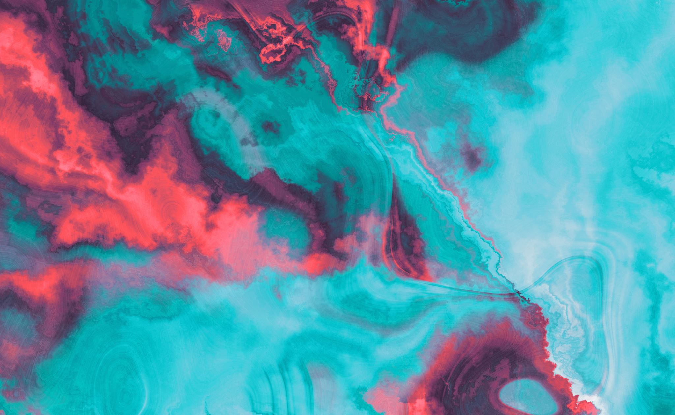
Group 7 Saima Sano, Zaid, Alisha D. Rush, Moahammed Farooq Abdullah ITAI-1378 Comp Vision Patricia Mcmanas
Land of Image Enhancement
Challenge 2

Slide 2
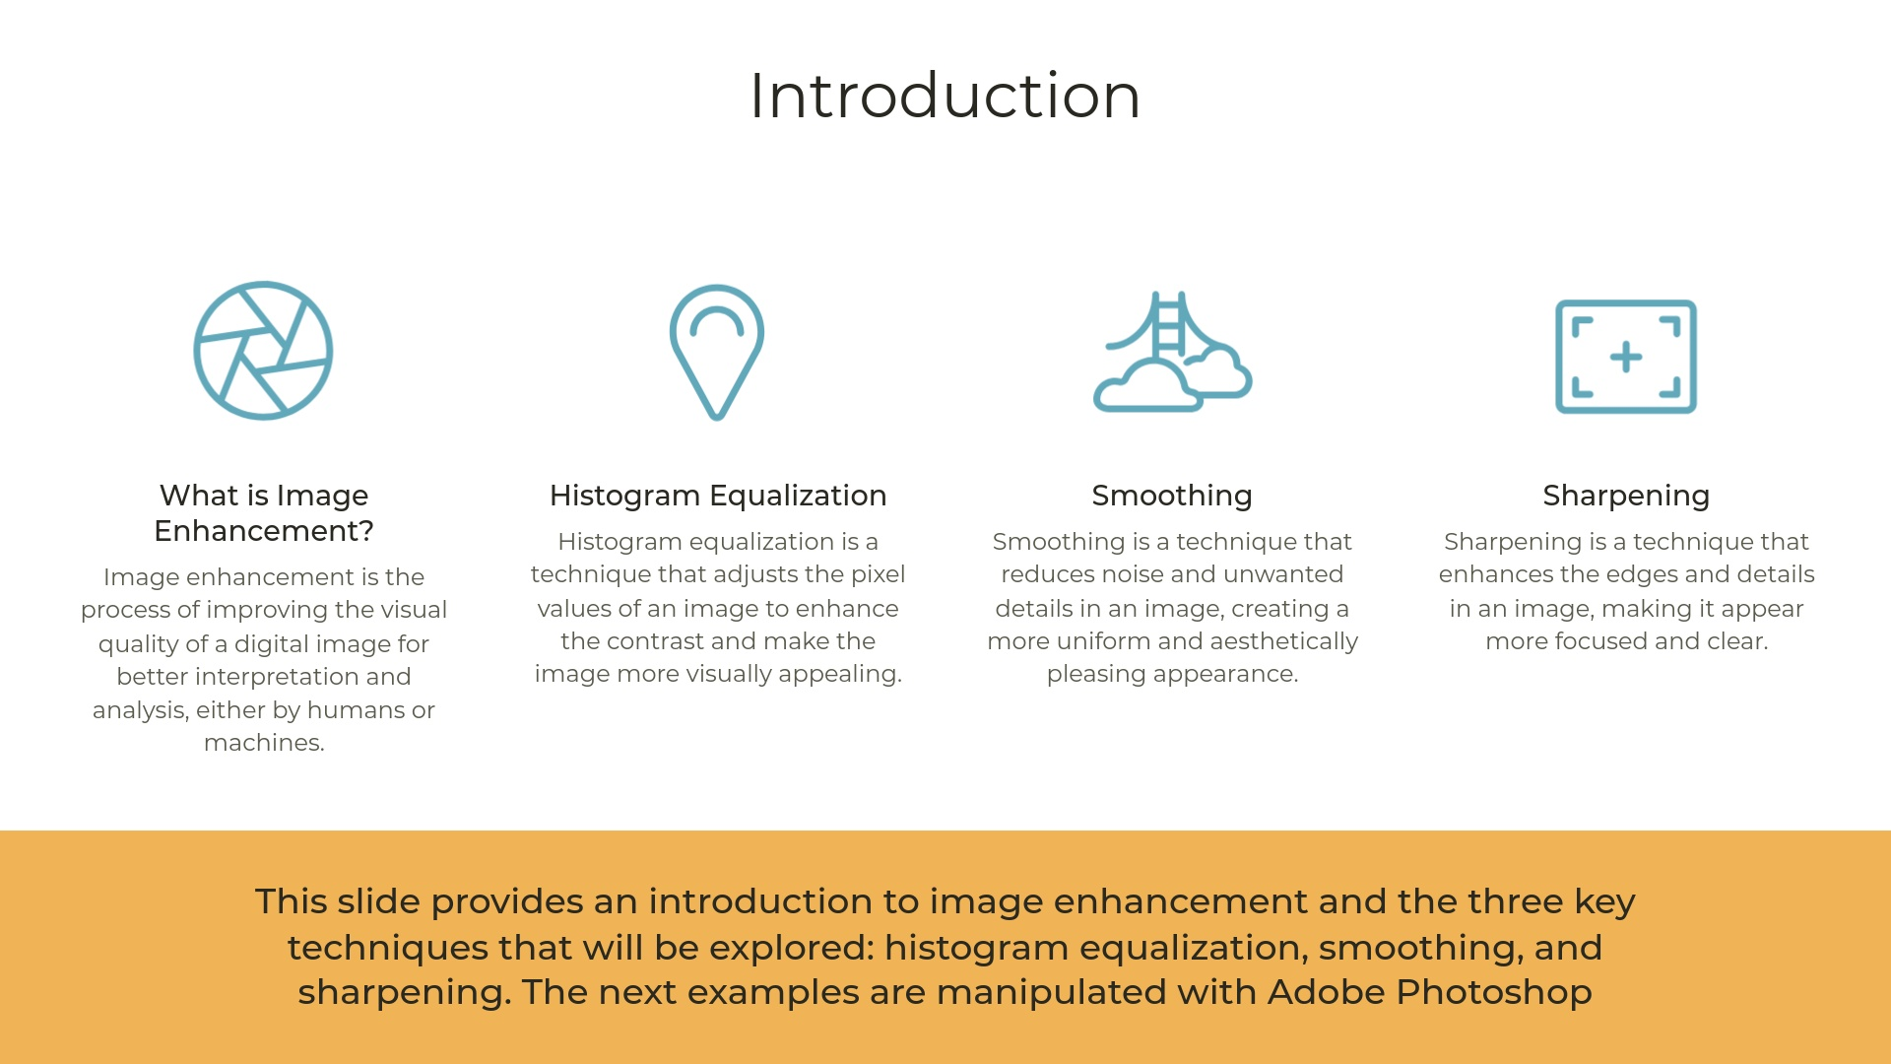
By: Alisha D. Rush

Slide 3
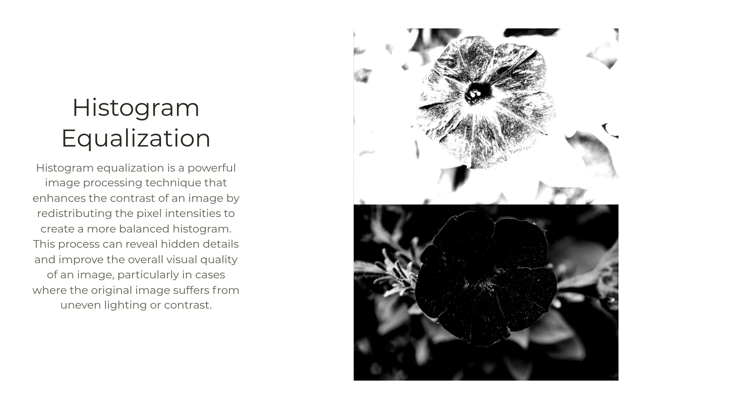
By: Alisha D. Rush

Slide 4
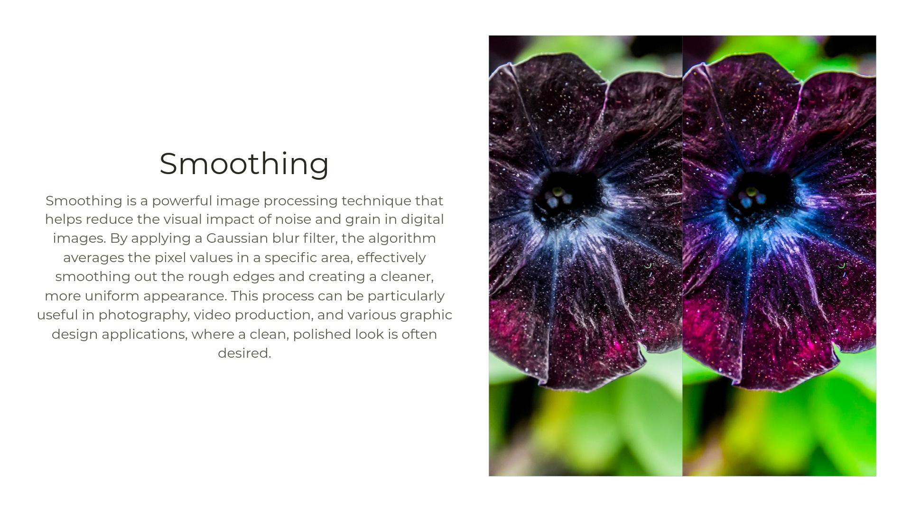
By: Alisha D. Rush

Slide 5
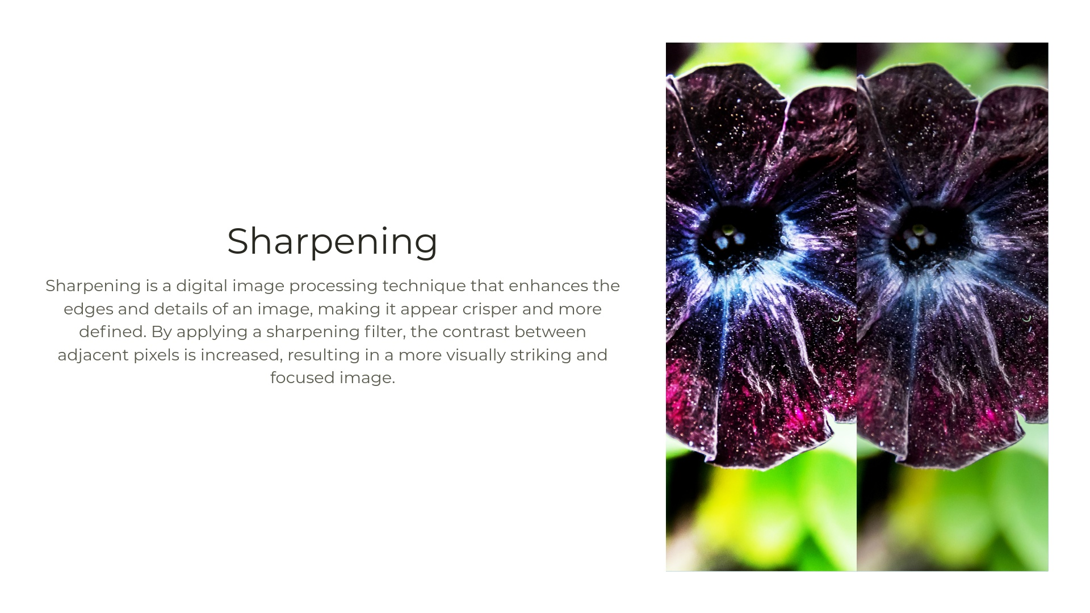
By: Alisha D. Rush

Slide 6
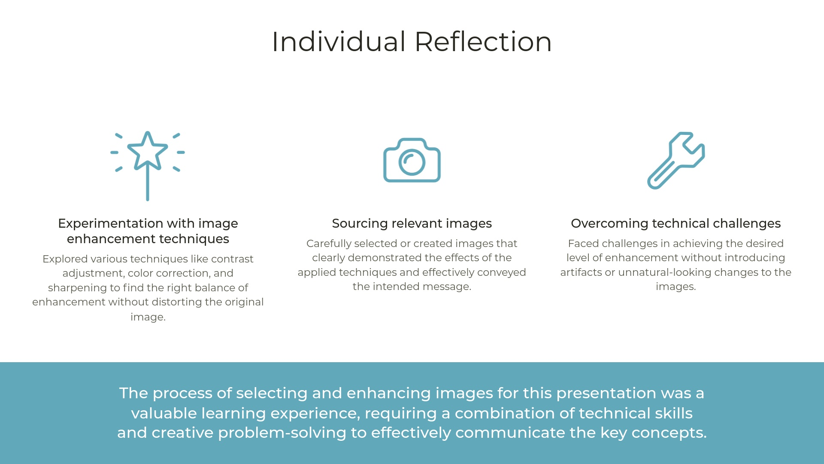
By: Alisha D. Rush

Slide 7
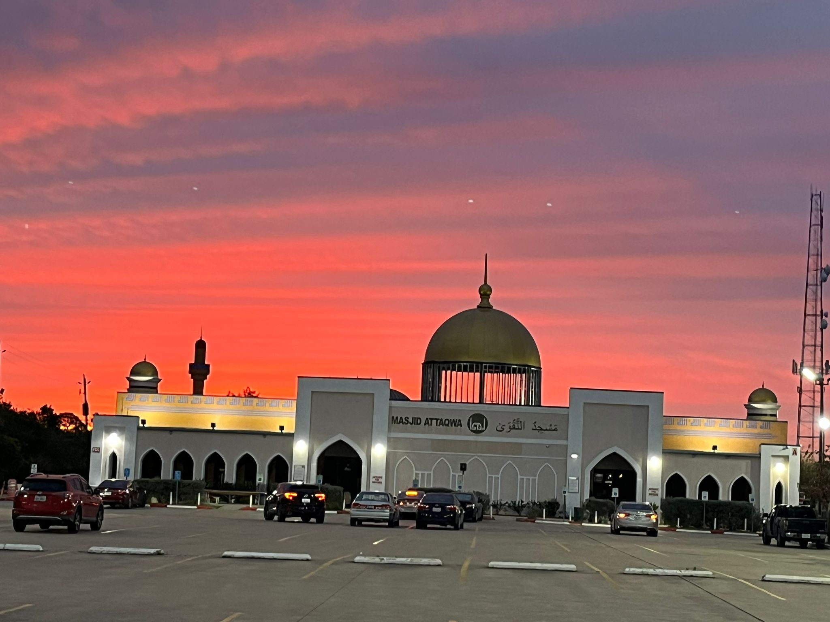
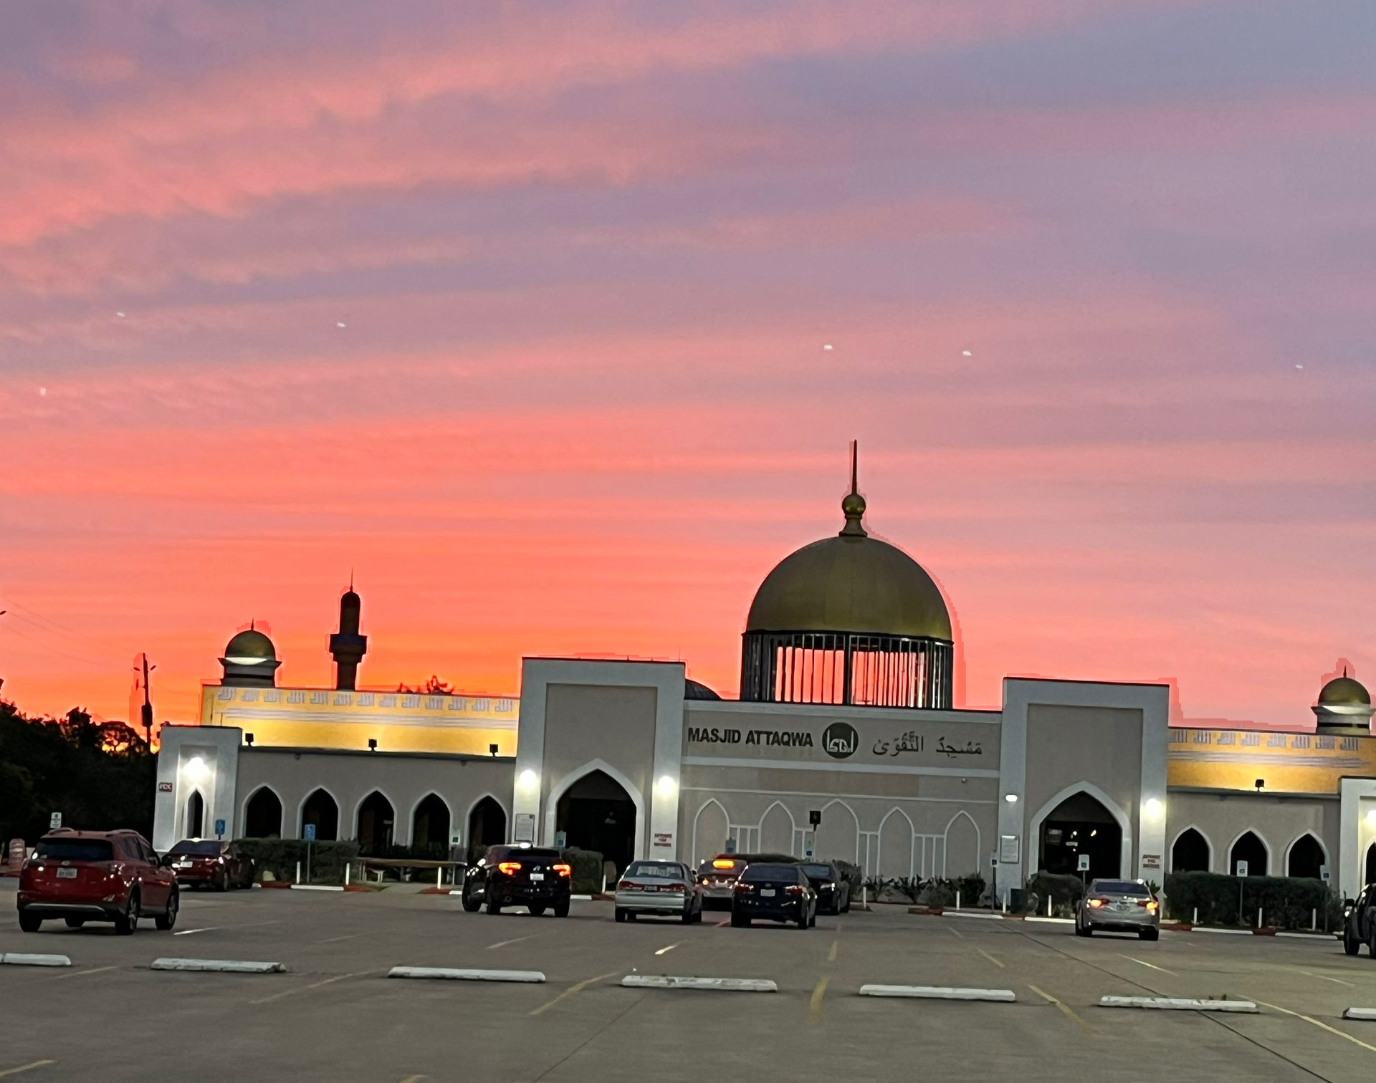
Enhancing Image by changing color and Saturation
Original Image
Enhanced Image
By: Saima Sano

Slide 8
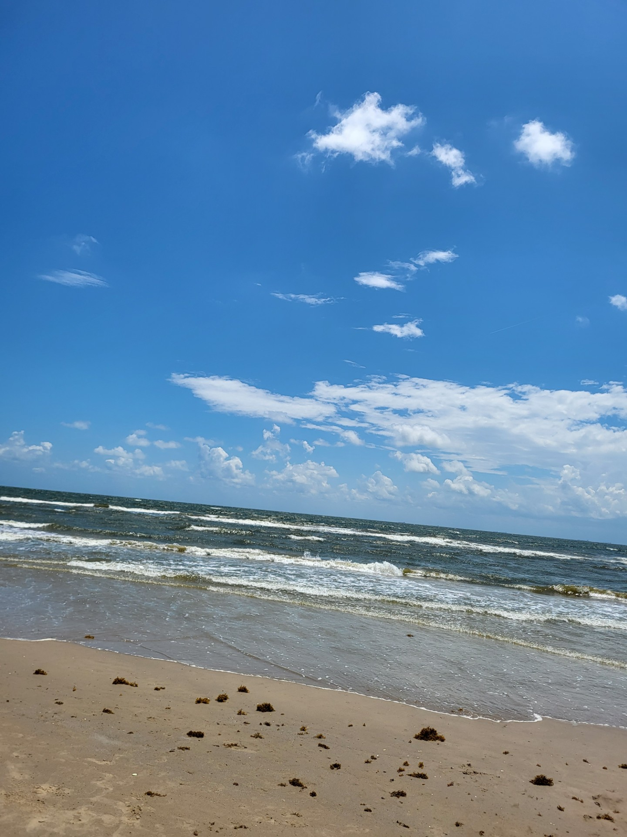
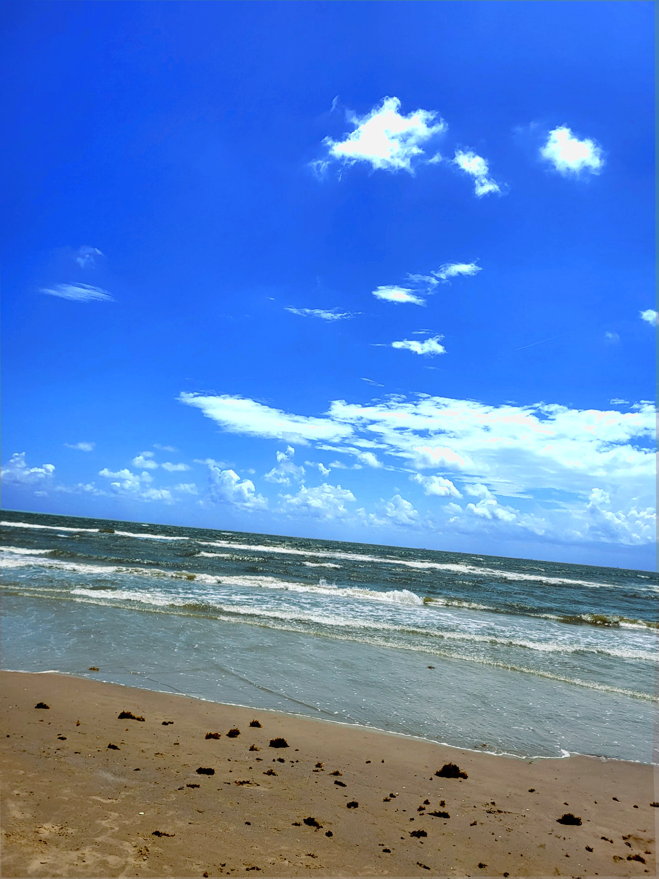
Original Image
Enhanced Image
By: Saima Sano

Slide 9
Reflection:
This project was exciting, but there was so much to learn and master that I felt I could not do my best. I tried learning OpenCV with Python and it became too overwhelming. Then, I searched for more software and downloaded GIMP. I watched many tutorials on how to use it and what are the available features.
Image 1: The image is from my gallery, I like sunset and want to capture the best shot. I felt the sky was too dark therefore when I was enhancing the image, I first used the free tool to divide the sky part of the picture from the rest of it. Then, I used curves under the color menu and changed the input to 114 and output to 143, to lighten the reddish orange tone in the sky. Then, I went to the saturation menu and decreased the saturation scale to 0.907. If the image is zoomed, my improper line will be shown.
Image 2: This image is from the time we went to Crystal Beach in August. In this picture, first I divide the picture into three parts, sky, water, and sand. I tried to create duplicate layers to work on it individually, but I could not merge all 3 layers successfully. So, I work on each part in the same picture. For the sky, I reduced the temperature to 4867 and then reduced Cyan and increased the Magenta level in color balance under the color menu. For water part, I increased the cyan but decreased the exposure and saturation to enhance the waves. I made the sand a little darker by changing the lightness in the Hue and Saturation menu from the color tab.
By: Saima Sano

Slide 10
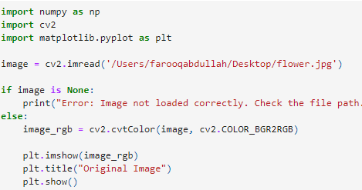
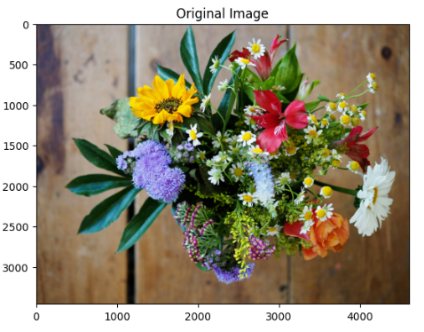
Image Enhancement through Python
By: Mohammad Abdullah Farooq

Slide 11
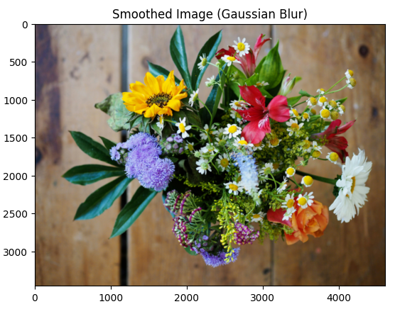
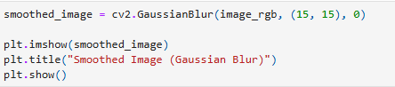
Smoothed image (Gaussian Blur)
By: Mohammad Abdullah Farooq

Slide 12
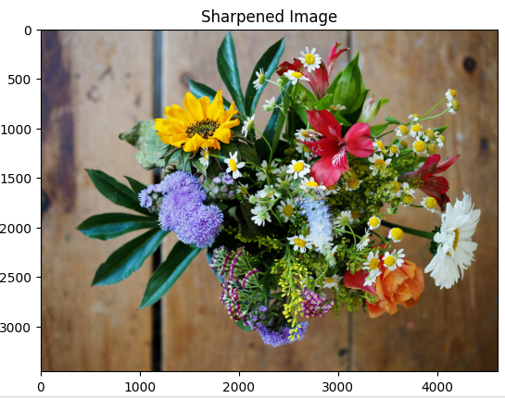
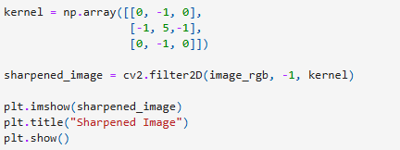
Sharpened Image
By: Mohammad Abdullah Farooq

Slide 13
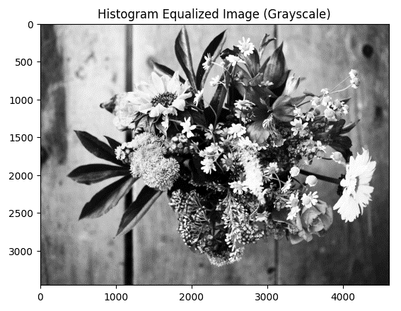
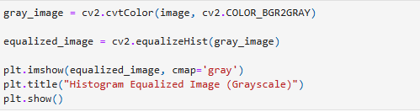
Histogram Equalized Image (GrayScale)
By: Mohammad Abdullah Farooq

Slide 14
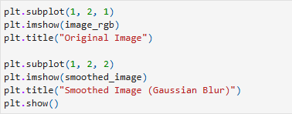
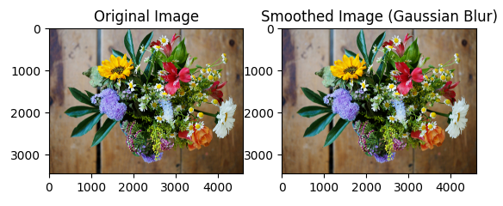
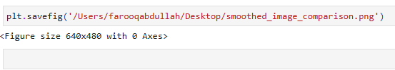
Comparison between original and enhanced image
By: Mohammad Abdullah Farooq

Slide 15
Reflection:
Summary of Each Enhancement Technique Using python 1. Smoothing (Blurring) the Image: o What You Did: Applied Gaussian smoothing to the image using a Gaussian Blur filter. This technique averages the pixel values within a certain neighborhood to reduce noise and detail. o How It Affects the Image: The smoothed image appears less sharp and more blurred compared to the original. This is because the filter reduces high-frequency components, which can help in noise reduction but may also lose some fine details. 2. Sharpening the Image: o What You Did: Applied a sharpening filter using a kernel that enhances edges by increasing contrast around them. This technique emphasizes transitions in pixel values to make edges more defined. o How It Affects the Image: The sharpened image shows enhanced edges and more defined details. This makes the image look clearer and crisper compared to the original. Sharpening increases contrast around edges, which can sometimes amplify noise. 3. Histogram Equalization: o What You Did: Performed histogram equalization on the grayscale version of the image. This technique redistributes the intensity values to improve the contrast of the image. o How It Affects the Image: The equalized image has improved contrast, making details more visible, especially in areas that were previously too dark or too bright. This results in a more balanced and visually enhanced image compared to the original.
By: Mohammad Abdullah Farooq

Slide 16
Continued from previous page
Reflection:
Insights from Each Image Enhancement Process 1. Smoothing (Blurring): o Insight: Smoothing is useful for reducing noise and detail, making it beneficial in applications where noise reduction is more important than preserving sharpness. However, excessive smoothing can blur important details and reduce overall image clarity. 2. Sharpening: o Insight: Sharpening can significantly enhance the clarity of an image, making it useful for applications where detail and edge definition are crucial. However, over-sharpening can introduce artifacts and accentuate noise, especially in low-quality images. 3. Histogram Equalization: o Insight: Histogram equalization improves contrast and enhances the visibility of details across various intensity levels. It’s particularly useful in improving the quality of images with poor contrast but can sometimes result in unnatural enhancements if overused. Differences Between Original and Enhanced Images 1. Smoothing (Blurring): o Original Image: Clear with all details visible. o Smoothed Image: Blurred appearance with reduced detail and noise, resulting in a softer look. 2. Sharpening: o Original Image: Standard sharpness with all details present but not emphasized. o Sharpened Image: Enhanced edges and more pronounced details, making the image look crisper and more defined. 3. Histogram Equalization: o Original Image: Contrast may be limited, with some details hidden in shadows or highlights. o Equalized Image: Improved contrast and visibility of details, with more balanced brightness and darkness, leading to a more dynamic and visually appealing image
By: Mohammad Abdullah Farooq

Slide 17
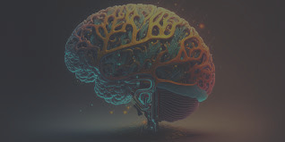
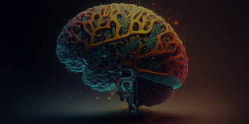
Bright and Contrast Adjustment through Gimp
Before: A dull image with low contrast and muted brightness.
After: The same image with improved brightness and contrast, making it more vivid.
By: Zaid Tahir

Slide 18
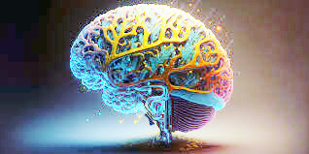
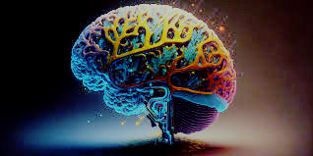
Histogram Equalization through GIMP
After: The image after applying histogram equalization to enhance contrast, making details more visible.
Before: An image with uneven lighting and poor contrast.
By: Zaid Tahir

Slide 19
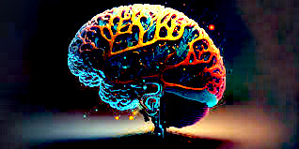
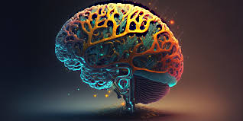
Sharpening through GIMP
Before: An image that appears blurry or lacks definition.
After: The sharpened image with enhanced edges and finer details.
By: Zaid Tahir

Slide 20
Reflection
Participating in the "Image Processing Adventure Quest" provided me with an exciting opportunity to dive into the technical and creative sides of image processing. Using GIMP, I focused on three primary techniques: brightness and contrast adjustments, histogram equalization, and sharpening. These methods helped me improve the quality of images and deepened my understanding of how essential these enhancements are in various fields, such as photography and graphic design.
I spent a considerable amount of time mastering brightness and contrast tools. Initially, I underestimated the impact that these adjustments could have, but after experimenting, I saw how crucial they are in bringing out details and improving image clarity. It was particularly interesting to see how fine-tuning the contrast could make an otherwise flat image feel more vibrant and dynamic.
Next, I explored histogram equalization, which was a bit challenging to grasp initially. However, once I applied it to images, the transformation was remarkable. By redistributing the light values across the image, I significantly enhanced contrast and brought out hidden details. This technique became one of my favorites because of how it subtly yet powerfully improved the image quality.
The last technique I focused on was sharpening. Using GIMP's sharpening tools, I learned how to enhance the edges of objects, making them more defined. I enjoyed experimenting with the degree of sharpening, realizing that too much could make the image appear unnatural, while just the right amount created crisp, detailed visuals.
Overall, this quest taught me how small adjustments can dramatically improve an image's clarity and detail. Working with GIMP, I not only enhanced my technical skills but also learned how these techniques can be creatively applied to communicate a story. The experience has given me a new appreciation for the art of image processing.
By: Zaid Tahir

